Slide 1

Pointers
What is our understanding of the problem in the market?
What solutions are there in the market?
How is our solution better than what is on the market?
How did we validate that the market will be willing to adopt our solution/platform
Competitor Analysis

Slide 2



Improving the value chain of unsold perishable food in supermarkets
Notes:
Reorganize slides
Survey at first - tie in with sustainable city
Road map: first grocerors then rest
Éxplain ‘reserve’system: payment
Deliver to soup, compost, powder articulate
explicit : app
Refine marketing strategy: be specific& decisive
Refine revenue: show projected revenue
# of ppl targeting-> convert -> 2018-2020
Key figures of costs (IT/dev/..) approx
Goal structure for reducing waste (numebrs)
Explain customer clearer -> PERSONA journey
CLARITY !!!!!!!!!!!!!!!!!!!!! && TELL A STORY
Competitor analysis (what others v what we are doing)
What stakeholders can gain -> value of stakeholders
Breakeven analysis
AVIVA: customer-brand interaction: collect customer info(data)/ run rewards prog/ buy&sell to get points towards policies(eg travel premium waived)? (+slide)
We have data on how people are eating -> insurance is lower!?
Feature: register upfront & immediately collect (push notification)
App referrals/ retention/ revenue & targets ==business case
Add prototype
ONLY 10 MINS - IMPORTANCE ON KEY POINTS
Dont need lean canvas

Slide 3


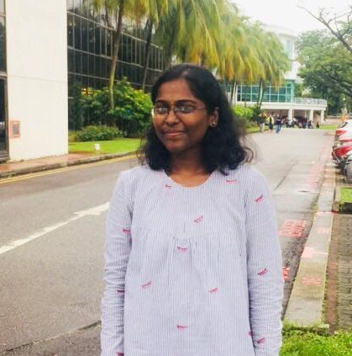

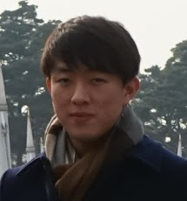
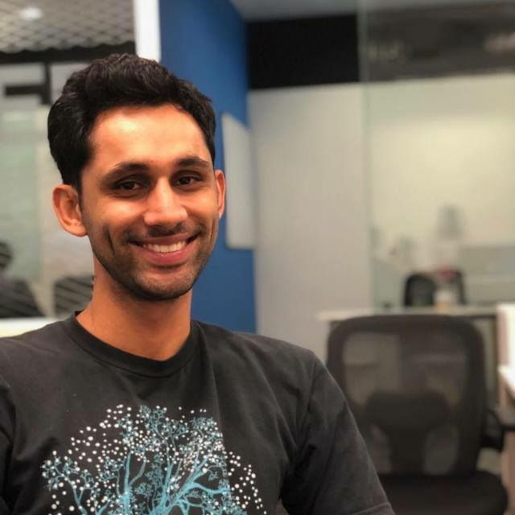



Who we are
A Group of Passionate Individuals
Judy Ong
Matthew Wong
Akshaya
Anto Lawrence
Digital Marketing
Graphic Designer
Developer
Aviva Guru
Collaborating partners:
Ferdi Lau
Jovi
Wei Chuen Kum
Financial Analyst
Data Analyst
Business Development

Slide 4
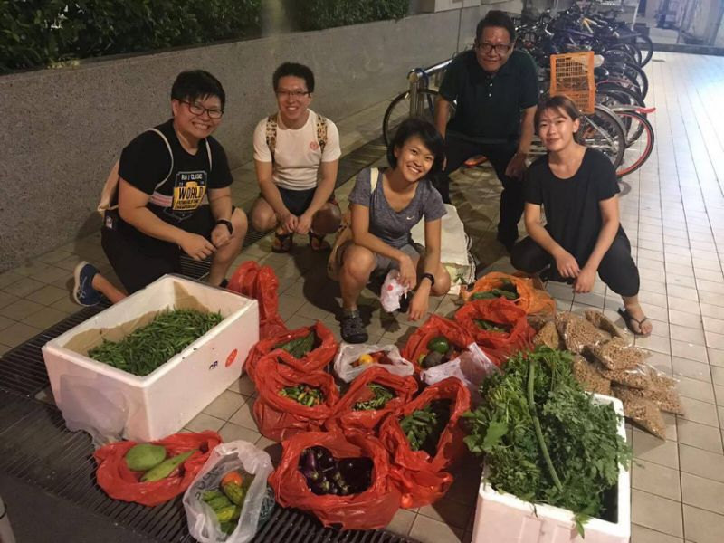

‘Freeganism’
Inspiration for our idea
Rising Trend of Millennials found digging through dumpsters
Source: Yahoo
Notes:
WHAT IS THE CUSTOMER PROBLEM?

Slide 5

Food Waste in Singapore
Quantifying the Severity of the Problem
2,160
Tonnes of food waste are generated in Singapore everyday (NEA, 2016)
...that’s equivalent to the weight of 432 school buses!
Notes:
As calculated by Jovi, Mathematician
1 ton = 2000 pounds
1 school bus = 10000 pounds
WHAT IS THE CUSTOMER PROBLEM?
Insert sources for the statistics (append to bibliography)
Stats for South East Asia to show the opportunity in Asia
In the world, 28% of the total food waste are from the Industrialized Asia (Japan, South Korea, and China), while the South and South East Asia waste 21%. The number showed that the level of wasted food in Asia is very high – nearly 50%.
While food waste is prevalent in the more developed economies of the region, it is a growing problem in the urban centres of many countries in Asia and the Pacific. On average, approximately 11kg of food per capita per year is wasted in developing Asian countries, while an estimated 80 kg of food per capita per year is waste in developed Asian countries (FAO, 2011).

Slide 6

Market Research
What did we find?
Only 14% of food waste is recycled
Perishables that do not pass cosmetic filtering test account for 60% of all food waste in Singapore (Fairprice, 2017)
Notes:
DEFINE COSMETIC FILTERING TEST WHEN PRESENTING

Slide 7
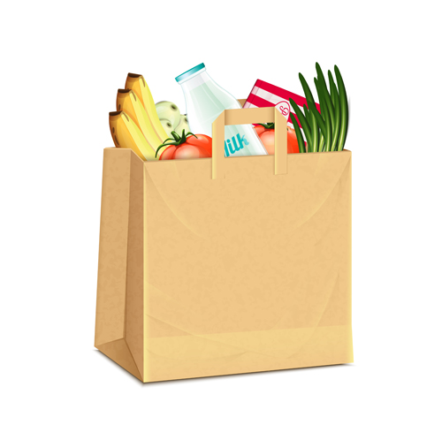
Food Waste in SE Asia
This problem affects SE Asia as well
11kg/capita per annum
80kg/capita per annum
Developing SE Asian countries
(i.e. Laos, Myanmar)
Developed SE Asian countries
(i.e. Singapore)
Source: Food and Agriculture Organisation, 2011)

Slide 8


Validation
What do Singaporeans think?
90% of Singaporeans are concerned about the issue (NEA, 2016)
95% feel the need to reduce food waste (Results from our survey with 113 respondents)
People want to get involved with reducing food waste!

Slide 9

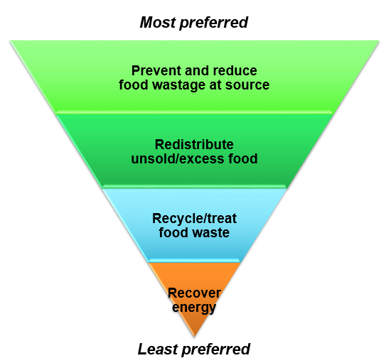






Current Solutions
Outreach Programmes
Education
Largely ineffective
Food sharing
Food bank
Donations
Onsite waste treatment
Composting
Biogas
Landfill
Incineration
Worst case scenario
Source: National Environmental Agency
Notes:
Thousands of people in the UK are increasingly reliant on food banks, the use of which has increased fourfold since 2012. Yet UK households threw away 7.3m tonnes of food in 2015, according to the environment, food and rural affairs committee.
Tesco uses an app, FoodCloud, developed by two Trinity College Dublin graduates, to itemise the surplus food in each store at the end of the day. This information is then shared with local charities that collect the food.

Slide 10
Improving the value chain of unsold perishable food in supermarkets

Slide 11
Customer Persona
“I care about our environment and I think we should increase food waste recycling!”
Name: Alastair
Age: 24
Occupation: Student
Additional info: Value-Seeker, Environmentally conscious, Millennial who wants to make a difference, Frugal spender

Slide 12

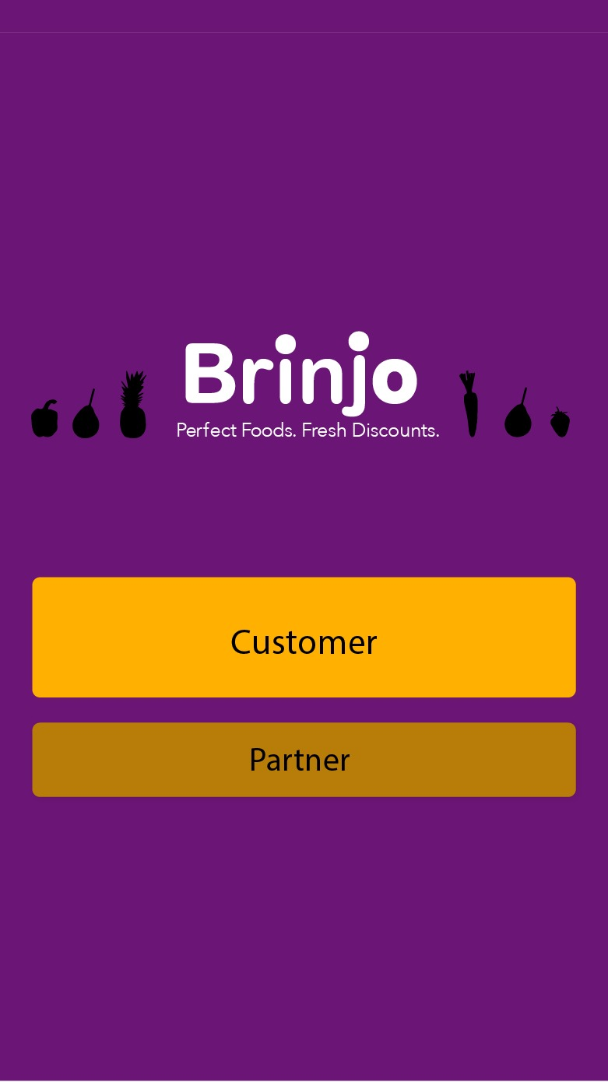
Our Solution
Inclusive Food Ecosystem
Integrated digital platform that connects supermarkets with unsold perishable food to value-seekers and/or the environmentally conscious
Goal: Reallocate perishable food efficiently to reduce overall food wastage in Singapore and ensure food sustainability (SDG #11)

Slide 13
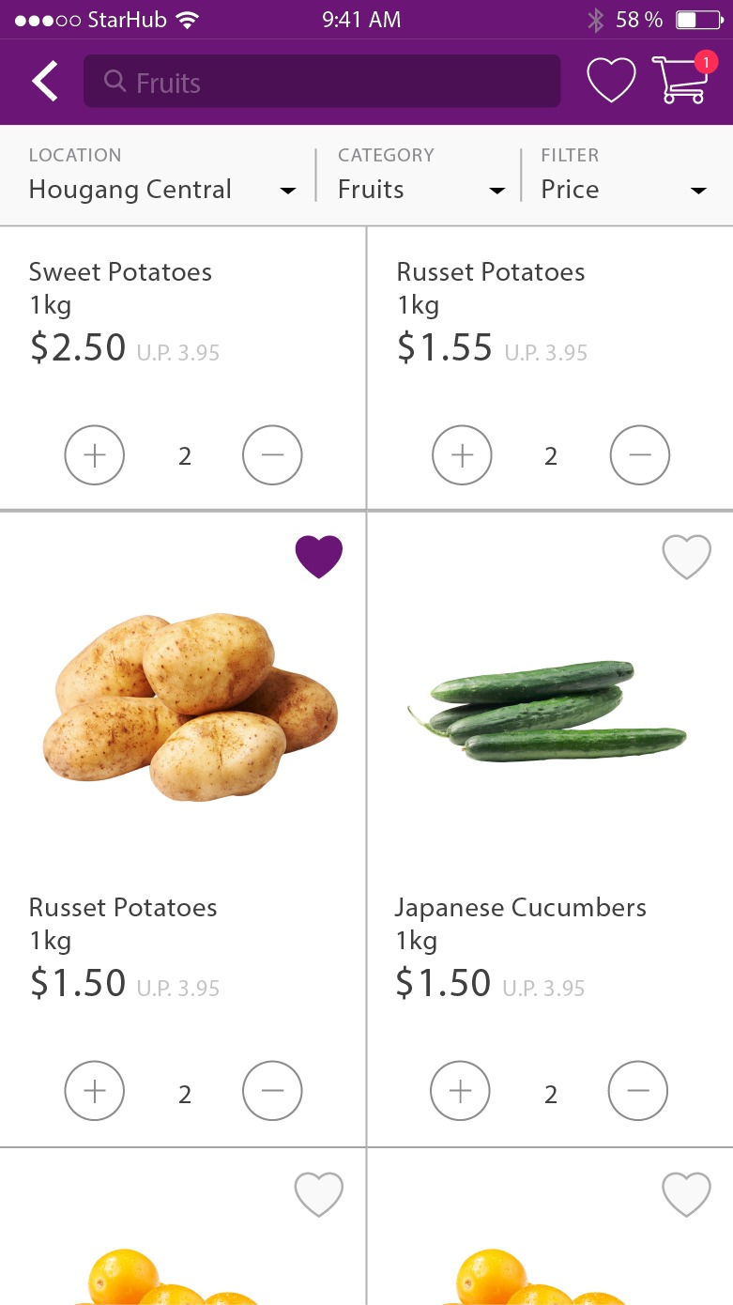
Our Solution
How it works
1. Food Matching
At the end of the day, unsold perishable food in supermarkets will be listed on our platform at discounted prices
Market Validation
✓ 60% are willing to purchase vegetables that do not pass the cosmetic filtering test
✓ 66% will make the purchase if the discount ranges between 30 - 50%
✓ 91% are willing to download and use this app

Slide 14




Our Solution
How it works
2. Redistribution of remaining food
Remaining food not sold by the end of the day will then be distributed to:
1. Soup Kitchens
2. Powder-processing companies
3. Compost facilities
Biomax Thermophilic Digester
Resulting in 100% of food waste from supermarkets recycled!

Slide 15





Improved Supply Chain
Horizontal and Vertical Integration
Customers
Soup Kitchens
Powder-processing companies
Supermarket
Compost
Vendors
Mobile App Platform
Redistribution
Notes:
Remove bakery,

Slide 16





Value Propositions
Pain reliever for supermarkets
The unsold perishable goods presents a significant loss in the daily revenue for supermarkets. The use of our platform will convert previously unwanted food to money for them
Gains creator for customers
Save money spent on groceries
Supermarket
Customer
In turn, this helps to reduce food waste & ensure food sustainability!

Slide 17









Stakeholders
Key Partners
Supply-side
Demand-side
Redistribution
Students
Supermarkets
Soup Kitchens
Value
Seekers
Powder- Processing
Facility
Bakeries
Environmentally
Conscious
Other Food
Establishments
Composting
Facility

Slide 18
Our App
The Customer Journey
Step 1:
Choose if you are a Customer / Partner
Step 2:
Customers get alerts when discounts are available in their proximity

Slide 19
Our App
The Customer Journey
Step 3:
Catalogue that shows a complete list of perishable food available at the end of the day
Step 4:
Reserve & Pay for your order on the app, and collect in store!

Slide 20
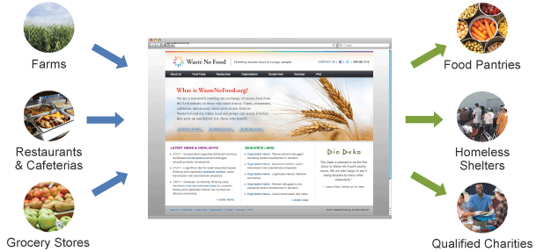
Competitive Advantage
What are the existing solutions
2016 French law bans grocery stores from throwing away edible food
Waste No Food, a nonprofit that has donated one million meals to California’s hungry and homeless population (May 2016)
Notes:
Government vs Non-profit vs Private firms

Slide 21
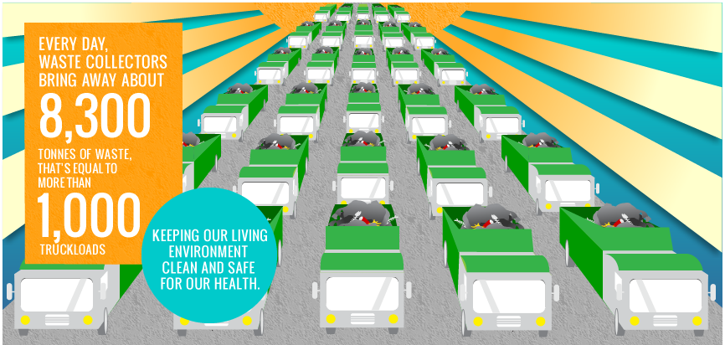


Competitor Analysis
Assessing the Impact-Effort Matrix
Modifying the Supply Chain
Education
Impact
Sharing Economy
Donation
Effort
Notes:
REFINE SLIDE

Slide 22
Proposed Roadmap
Go-to-market Strategy
Year 1 | Year 2 | Year 3 | Year 4 | Year 5
Build & Refine app Intensive onboarding of core customers: 20,000 app users Major Supermarket Chains Willing Hearts Composting facilities Powder-processing 10,000 tonnes of food redistributed | Customer Acquisition Onboarding of vendors: Bakeries Wet markets Hawker Centres Restaurants Improve redistribution channel: 20,000 tonnes of food redistributed | Expansion into neighbouring markets Strengthening local presence Finetune community and ecosystem 30,000 tonnes of food redistributed | Intensive onboarding in neighbouring markets Strengthening local presence 40,000 tonnes of food redistributed | Strengthening overseas and local presence 50,000 tonnes of food redistributed
Notes:
REDO SLIDE
How we intend to expand to South East Asia - best to illustrate how the markets and behaviours are similar (high food wastage, youth engagement etc)
Establish strong ecosystem: demand matching and redistribution channels
1st year target: raw food wastage

Slide 23






Channels
How do we intend to reach our customer segment?
Digital Marketing
Campaigns
Storefront Publicity
Collaboration

Slide 24






Key metrics
How to determine our success?
Consumers
Vendors
Sustainability
App downloads
Number of merchants listed
Amount(kg) of food recycled
User registration, retention, referrals,
# of in-app reservations
Conversion rate of merchants
Sustainable business model
Notes:
Revenue
Merchant conversion rate: (# of items sold/ # of items listed)

Slide 25
Revenue Stream
Feasible and Sustainable Business Model
Revenue Stream | Cost Breakdown
Commission fee (customer) | CAC (e.g. Marketing) 35%
Commission fee (merchant) | Logistics 10%
Commission fee (soup kitchen) | Platform 20%
 | Manpower 35%
Reservation fee (5-7% of dollar transactions)
Subscription fees (10% of dollar transactions)
Notes:
TIE IN W CUSTOMER SEGMENT - DO TMR

Slide 26
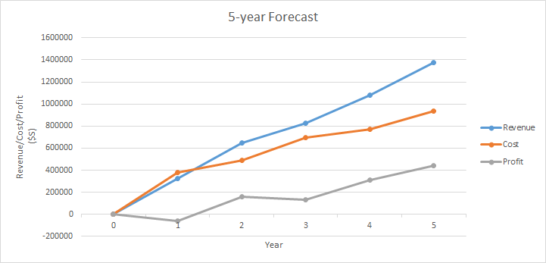
Projections
Our Quantifiable Impact and Financials
Notes:
Projections of revenue based on estimated reach
3 year, 5 year etc
Breakeven?

Slide 27




Integration with Aviva
Leveraging on Aviva’s Digital Edge
Reward System
Point accumulated through purchase converted to policy discounts
Customer Data
Used to formulate personalised plans and policies
Aviva’s Value
Preparing for uncertainty, protecting things important to customers, in terms of financials, the environment, and community
Notes:
We have data on how people are eating -> insurance is lower for reviva members
REFINE TMR

Slide 28
Thank you!

Slide 29

Q&As

Slide 30
Exhibits
Exhibit 1: Survey Results
Exhibit 6: Proposed Solution
Exhibit 2: Cost Structure
Exhibit 7: Key Metrics
Exhibit 3: Projection
Exhibit 8: Channels
Exhibit 4: Supply Chain
Exhibit 9: Prototype
Exhibit 5: Roadmap
Exhibit 10: Revenue Stream

Slide 31
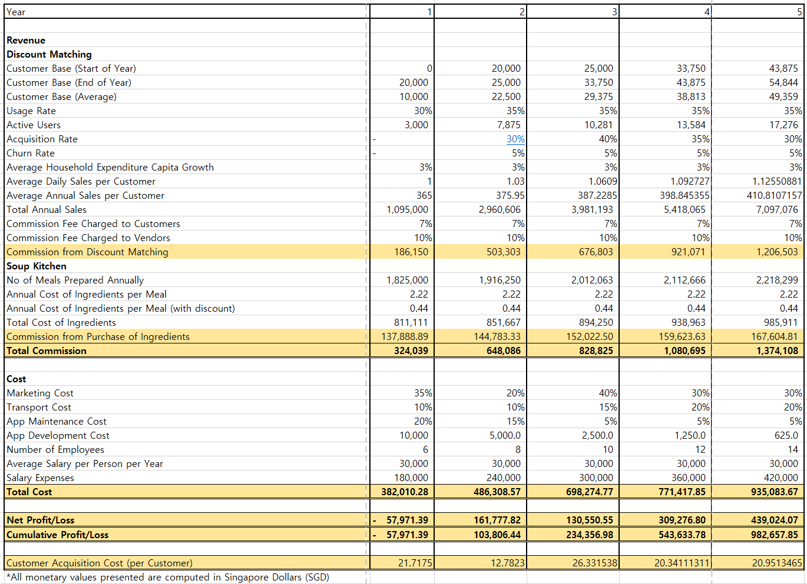
Exhibit 2: Cost Structure
Back

Slide 32
Exhibit 3: Projection
Back

Slide 33

Exhibit 4: Supply Chain
Back
Customers
Soup Kitchens
Our
Business Model
Supermarkets/ Food Stores
/ Markets
Powder
Compost
Vendors
Platform
Redistribution

Slide 34
Exhibit 5: Roadmap
Back
Year 1 | Year 2 | Year 3 | Year 4 | Year 5
Build & refine app Intensive onboarding of core customers: 20,000 app users Major Supermarket Chains Willing Hearts Composting facilities Powder-processing | Customer Acquisition Onboarding of vendors: Bakeries Wet markets Hawker Centres Restaurants Improve redistribution channel: | Expansion into neighbouring markets Strengthening local presence Finetune community and ecosystem | Expansion into neighbouring markets Strengthening local presence | Strengthening overseas and local presence

Slide 35
Exhibit 6: Solution
Our Solution
How it works
Back
1. Food Matching
At the end of the day, unsold perishable food in supermarkets will be listed on our platform at discounted prices
Market Validation
✓ 60% are willing to purchase vegetables that do not pass the cosmetic filtering test
✓ 66% will make the purchase if the discount ranges between 30 - 50%
✓ 91% are willing to download and use this app

Slide 36
Exhibit 6: Solution
Back
2. Redistribution of remaining food
Remaining food not sold by the end of the day will then be distributed to:
1. Soup Kitchens
2. Powder-processing companies
3. Compost facilities
Biomax Thermophilic Digester
Resulting in 100% of food waste from supermarkets recycled!

Slide 37
Exhibit 7: Key Metrics
Back
Consumers
Vendors
Sustainability
App downloads
Number of merchants listed
Amount(kg) of food recycled
User registration, retention, referrals,
# of in-app reservations
Conversion rate of merchants
xxx

Slide 38
Exhibit 8: Channels
Back
Digital marketing
campaigns
Collaboration with
NEA, AVIVA
Storefront publicity

Slide 39
Exhibit 9: Prototype
Back
Step 1:
Choose if you are a Customer / Partner
Step 2:
Customers get alerts when discounts are available in their proximity

Slide 40
Exhibit 9: Prototype
Back
Step 3:
Catalogue that shows a complete list of perishable food available at the end of the day
Step 4:
Reserve & Pay for your order on the app, and collect in store!

Slide 41
Exhibit 10: Revenue
Back
Reservation fee (5-7% of dollar transactions)
Subscription fees (10% of dollar transactions)
Revenue Stream | Cost Breakdown
Daily Sales per customer | CAC (e.g. Marketing) 35%
Commission fee (customer) | Logistics 10%
Commission fee (merchant) | Platform 20%
Commission fee (soup kitchen) | Manpower 35%

Slide 42
Our Solution
Virality
What will pull customers in? Ability to buy/sell unsold food, and to help the environment
How the idea will spread? Referrals, awareness campaigns, government cooperation
How to make sure to obtain scale? Achieve 100% food recycling from user to composting

Slide 43

Preliminary Findings
We conducted a survey of 105 respondents
88% are concerned about the hygiene and quality
60% will be willing to purchase vegetables that did not pass the cosmetic filtering test
66% will consider if the discount is between 30-50%
91% indicated they would download this app
People want to get involved with reducing food waste
Notes:
Insert sources for the statistics (append to bibliography)

